Slide 1
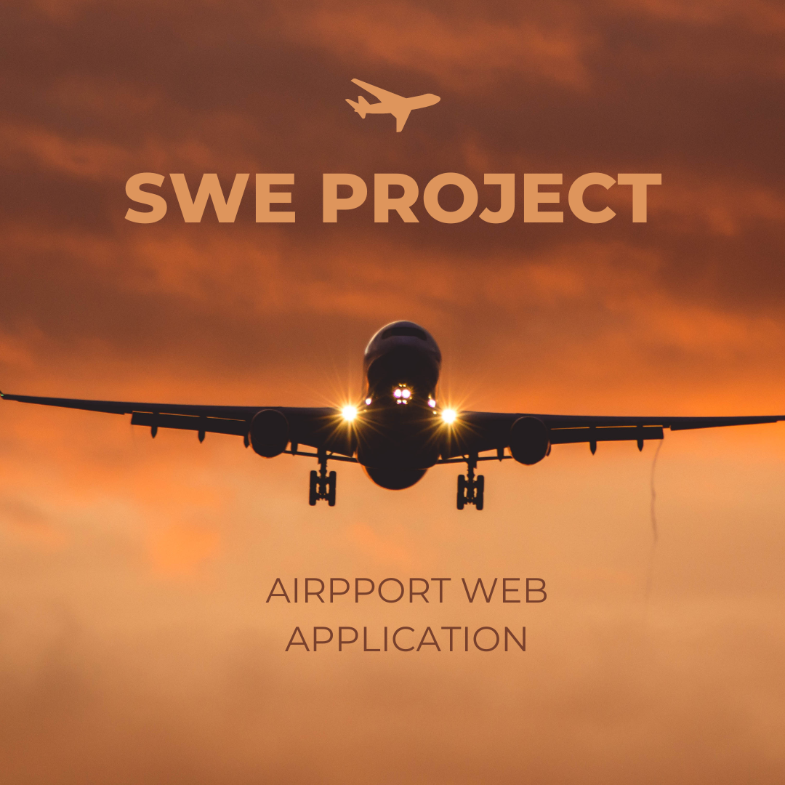


Slide 2
Team Members
Prepared By:
Hassan Adel
Ahmed Ehab Mahmoud
Mariam Alaa-ElDin Mohamed
Khaled Tarek
Hossam Mostafa El-Sayed
Presented to : Dr Manal and Eng. Solwan Mohamed

Slide 3
Introduction
Objective of our Application is to allow users to book a ticket after choosing departure and destination airport as long as the date wanted.
The user creates an account with all his credentials stored in our database
The user then uses that account and searches for the flight and books the flight after confirming his payment information.

Slide 4
Introduction
Airline web system application was created using following concepts
Front-End HTML and css using visual studio code
Back-end python using visual studio code
Database and SQL using mySql

Slide 5
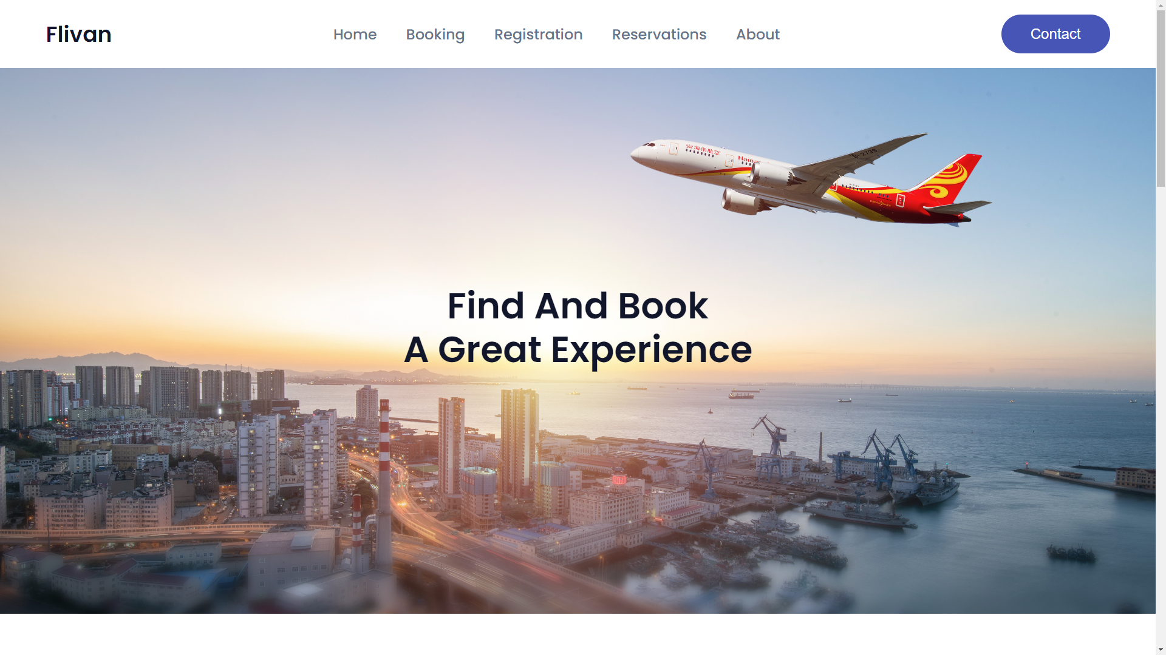

Slide 6
Homepage
The user is given option to login using a previous registered email and password
If the user has no account he creates a new account
An an option is also given to forget and reset a password if a password is forgotten

Slide 7
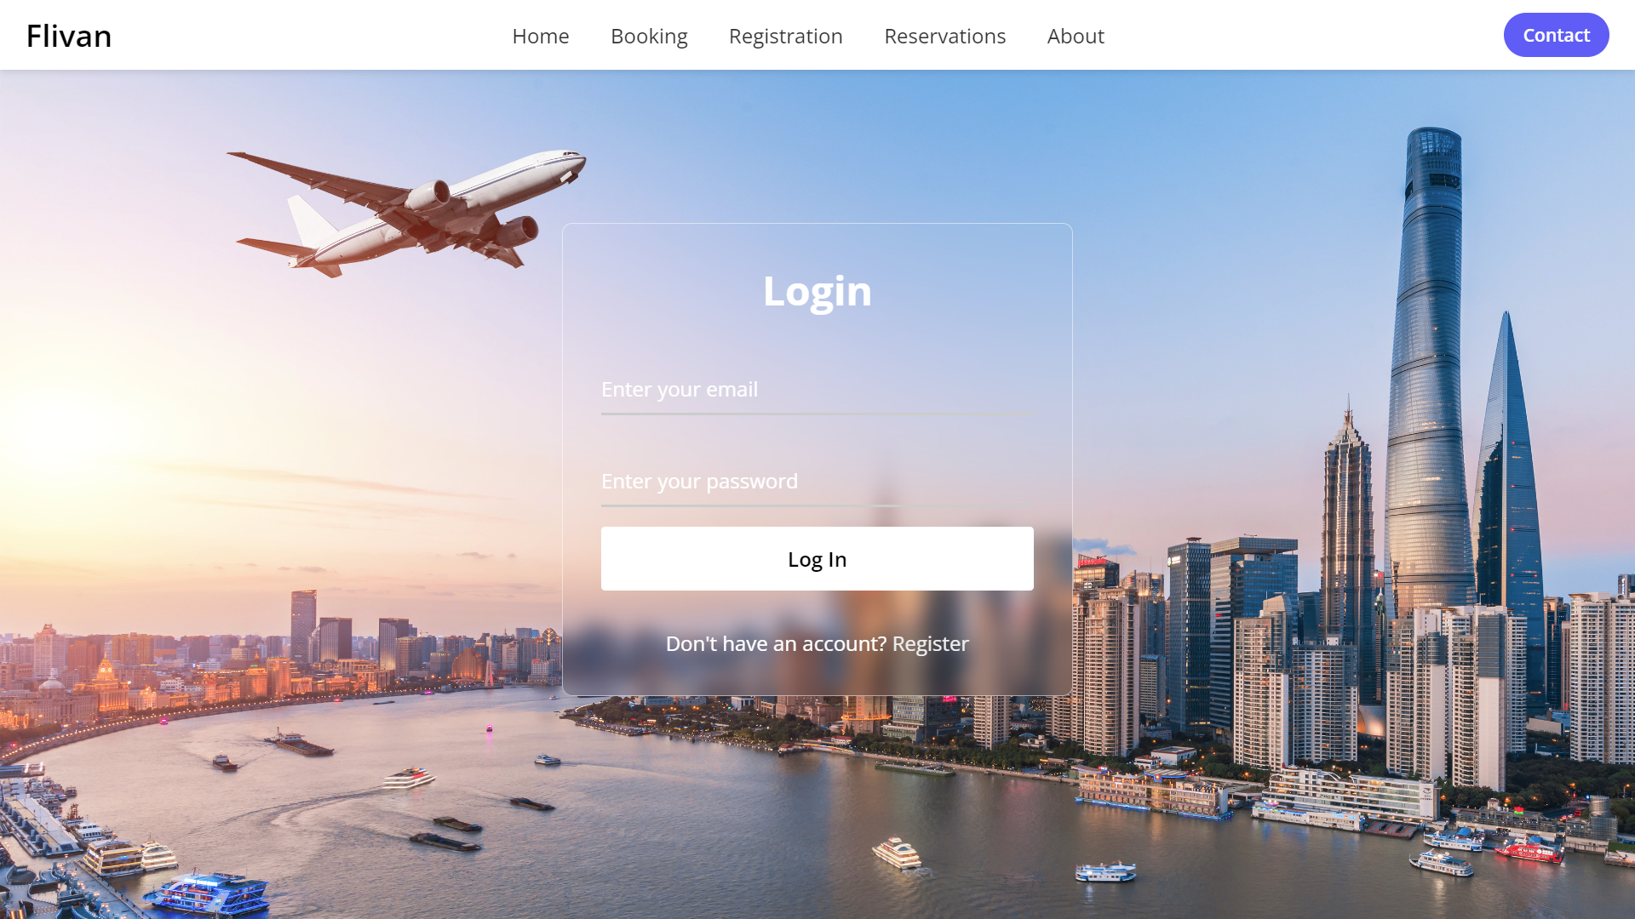

Slide 8
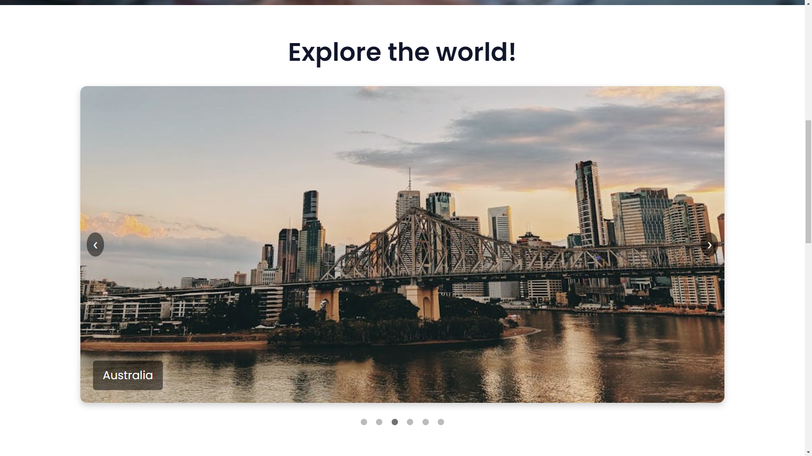

Slide 9
Homepage buttons section
The user as he scrolls down is given three options:
Book & relax
Flight status
Offers

Slide 10
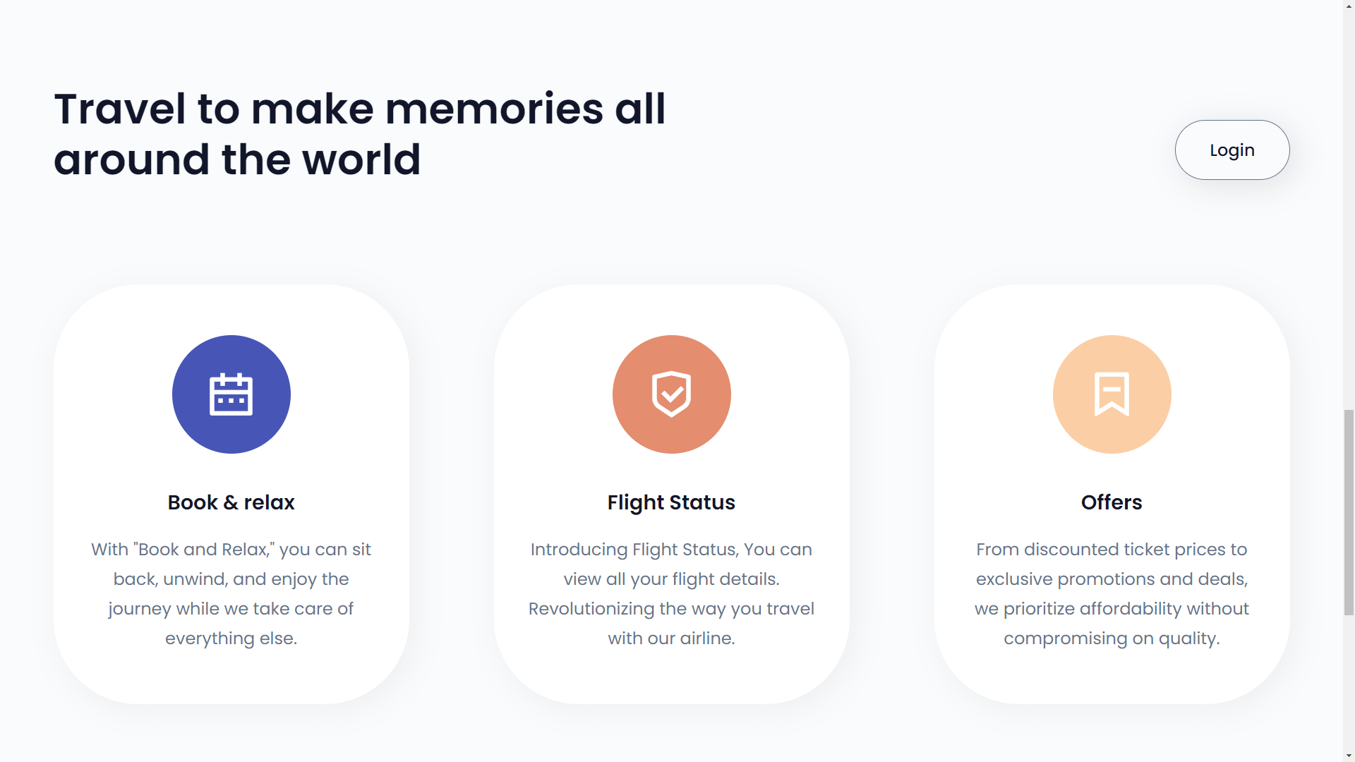

Slide 11
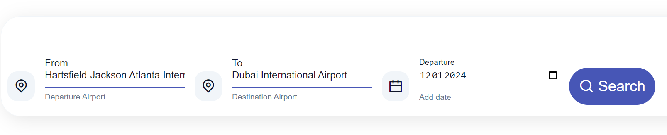
Book & relax
The user can select their flight by choosing an airport departure and destination locations as well as Departure date using a drop-down list.
The user then Searches using Search button and shows if following dates have available flights in specified airports

Slide 12
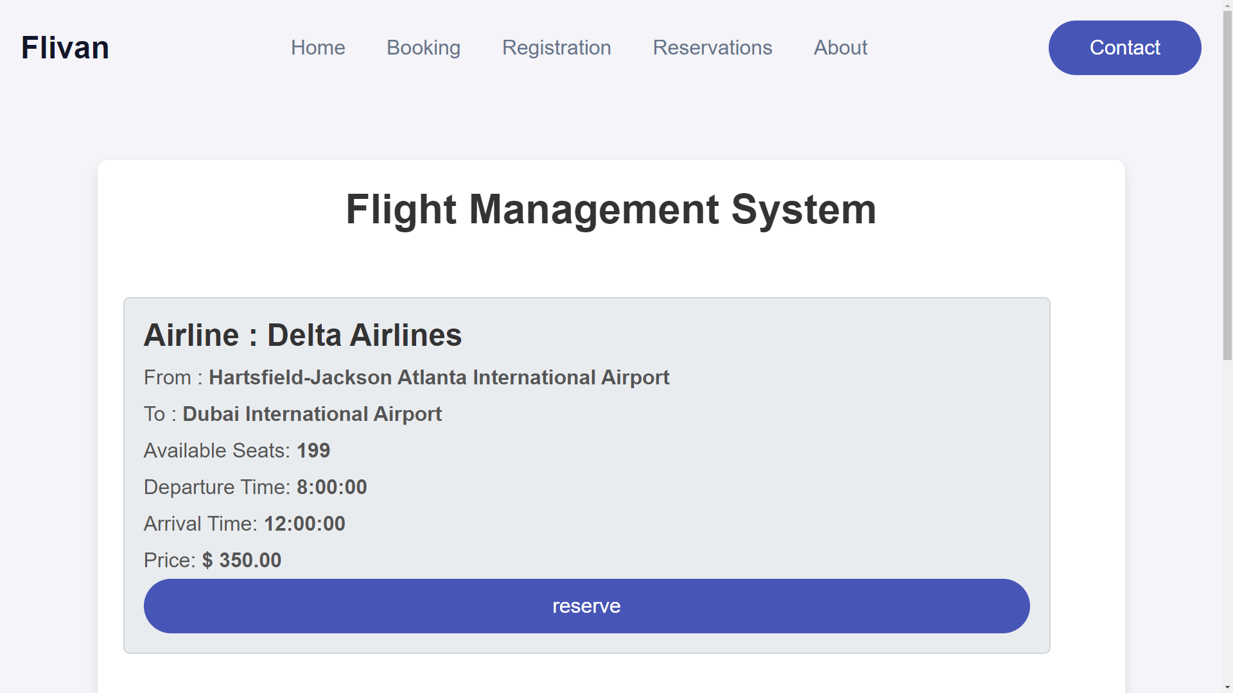

Slide 13
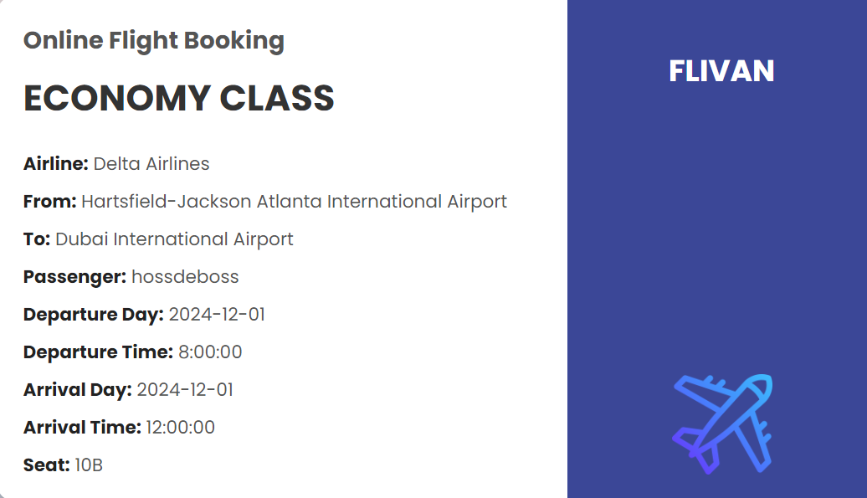
Book & relax
The user then confirms his reservation and his ticket will be shown

Slide 14
Flight Status
User can view his reserved ticket and departure/arrival times and they are informed if any changes/updates are made to timings through Flight Status Button

Slide 15
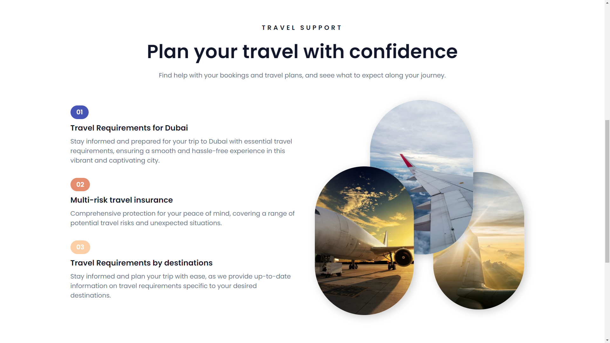
Offers

Slide 16
Offers
Any offers provided by our website will be presented in offers section
The user then chooses his appropriate-liking offer such as booking several flights for cheaper price than booking a single flight

Slide 17
Web Design
The previous image designs were created using HTML and css.
Navigation bars and sections were used to divide homepage
Buttons were used as hyperlinks to other pages when clicked , current page is closed and new page is opened.

Slide 18
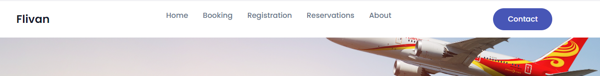
Navigation Bar
HTML was used to create navigation bar with several hyperlink buttons
that redirect user to specific webpage
Facilitates Navigation as Provides users with easy access to essential
website sections like Booking, Registration, and Reservations
Contact button for example redirects user to an email application to
send a customer support ticket

Slide 19
Database
Database was created using mySQL server that included creation of several tables with data insertion and updating or deletion.
Database connection was done by mysql.connector
Database stores users information like his username,email,password and passport number.

Slide 20
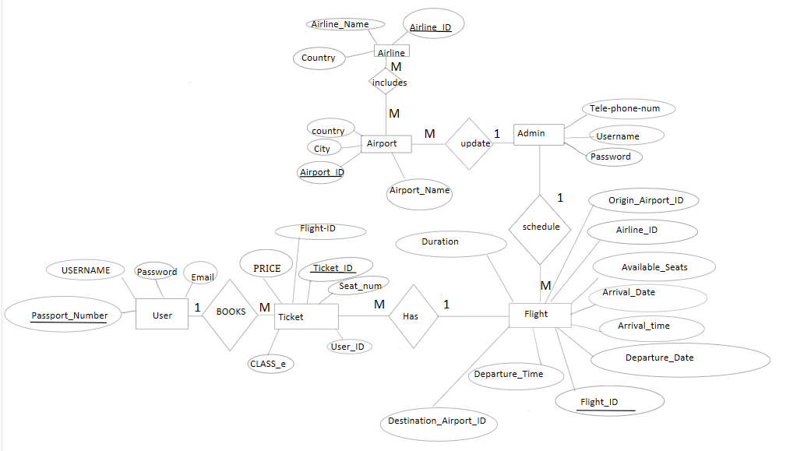
ER-Diagram

